Slide 1
Level 1/ College Certificate Induction Task There is no minimum number of words for your assignment and it may be handwritten if preferred . Please bring your completed assignment to college on the first day of term to be marked Should you have any queries regarding the task, please do not hesitate to contact us by email @ steven.salt@sheffcol.ac.uk derek.piper@sheffcol.ac.uk louise.lioux@sheffcol.ac.uk

Slide 2
Name the 6 Bread products that we will be making on your Bakery course ?
When you have identified the products, research using the internet to see if you can find a recipe for each of the products, with a method of production for each product.

Slide 3
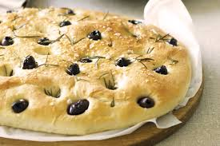
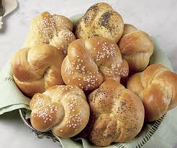
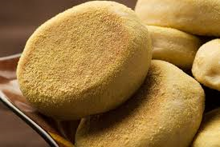
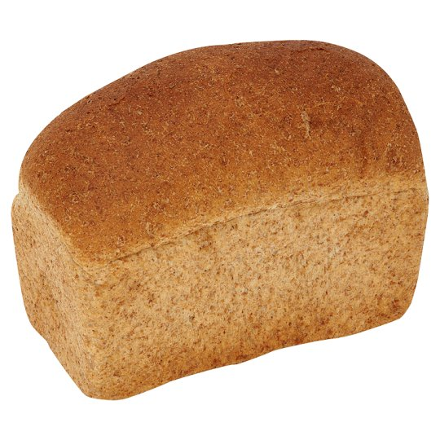
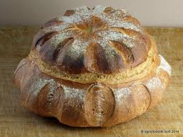
Bread products

Slide 4
Name the 6 Confectionery products that we will be making on your Bakery course ?
When you have identified the products, research using the internet to see if you can find a recipe for each of the products, with a method of production for each product.

Slide 5
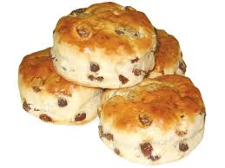
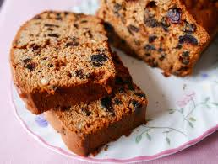
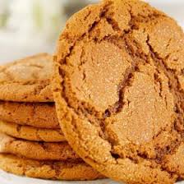
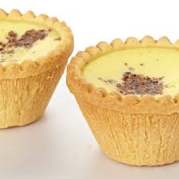
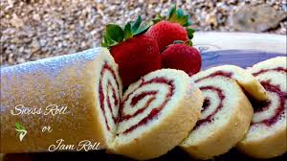
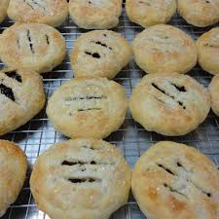
Confectionery products

Slide 6
Health & Safety questions to research using the internet
State types of protective clothing and headgear to be used in food operations ?
State the importance of following handwashing requirements ?
State why jewellery & cosmetics may be a food safety risk in the bakery ?

