Slide 1
Civil Engineering & Construction Management
Pre-enrolment Study Pack 2020

Slide 2
Pre-enrolment Pack Contents
Course Design and Dates.
Course Overview.
Task 1: Have a Go Question.
Level 3 Course Units.
Course Equipment.
Task 2: Have a Go Question.
Google Classroom.
Google Meet.
Task 2: Have a Go Question.
Meet the team.
Contact details.

Slide 3
Course Design and Dates
Course dates 2020-2022
Pearson BTEC Level 3 National Extended Diploma in Construction and the Built Environment
Pearson BTEC Level 3 National Extended Diploma in Civil Engineering

Slide 4
Course Overview – Who we are.
The term ‘Built Environment’ refers to aspects of our surroundings that are built by humans, that is, distinguished from the natural environment. It includes not only buildings, but the human-made spaces between buildings, such as parks, and the infrastructure that supports human activity such as Education Buildings, Transportation, Healthcare, Utilities, Flood Defences & Telecommunications.

Slide 5
TASK 1: Have a Go Question
What areas of work do Construction Technicians cover?
What areas of work do Civil Engineering Technicians cover?

Slide 6
Level 3 Course Units
Construction Principles
Construction Design
Tendering and Estimating
Construction Technology
Health and Safety
Surveying in Construction
Graphical Detailing
Building Regulations and Control
Management of a Construction Project
Building Surveying in Construction
Low Temperature Hot Water Systems
Measurement Techniques in Construction
Provision of Primary Services in Buildings
Further Mathematics for Construction
Projects in Construction
Building Information Modelling
Quantity Surveying
Construction in Civil Engineering

Slide 7
Course Equipment
Basic stationary (Pens, Pencils, Ruler etc.).
A4 Lined paper.
Scientific Calculator.
Mechanical Drawing Pencils.
USB.
Positive attitude.

Slide 8
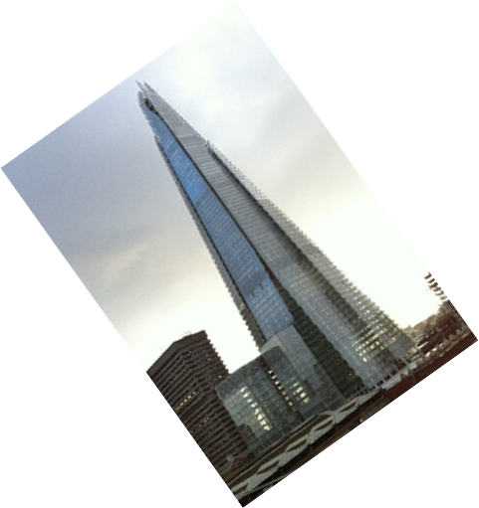
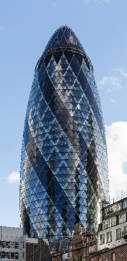
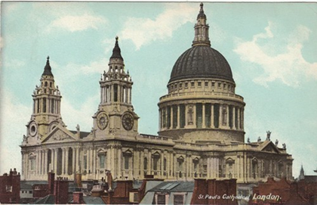
TASK 2: Have a Go Question
Name the Buildings and Architects who designed them?

Slide 9
Using Google Classroom
The course assignments will involve you accessing Google Classroom. This will enable you to complete assignments through coursework and homework study. You will be given a unique class code to help you access the classroom.

Slide 10
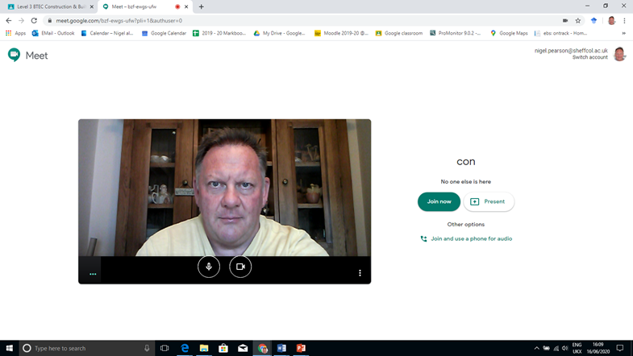
Using Google Meet
Due to the current social distancing measures, we will be using Google Meet as a link to enable information to be passed to students where attendance to college may be restricted at times. Throughout the course you will have the opportunity to meet with your colleagues, give presentations and talk with the tutor through this media stream.

Slide 11
TASK 3: Have a Go Question
What type of superstructure has been used to construct the following buildings?
How much concrete was used to construct the foundations of each building?

Slide 12
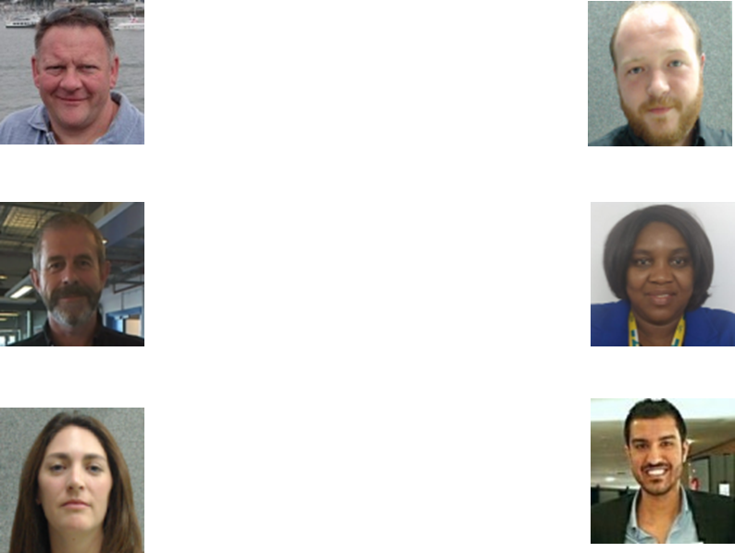
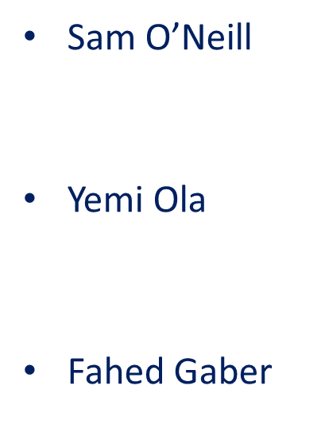
Meet the team.

Slide 13
Contact Details
Name: Mr Nigel Pearson
Title: Level 3 Construction and the Built Environment Course Leader
Tel No: 2602600
Email: nigel.pearson@sheffcol.ac.uk

